Slide 1

BUSINESS DATA MANAGEMENT
CAPSTONE PROJECT
Improving Performance at Apollo Pharmacy
Name : HARSH RAJ
Roll No : 22F3002552
Email: 22f3002552@ds.study.iitm.ac.in

Slide 2

Contents
1) Executive Summary | Introduction to business
2) Data Collection & Cleaning | Data Collection and Cleaning Steps
3) Data Analysis | Analysis done with respect to the challenges
4) Findings | Important Insights about business
5) Recommendation | Solutions/Recommendations for business

Slide 3
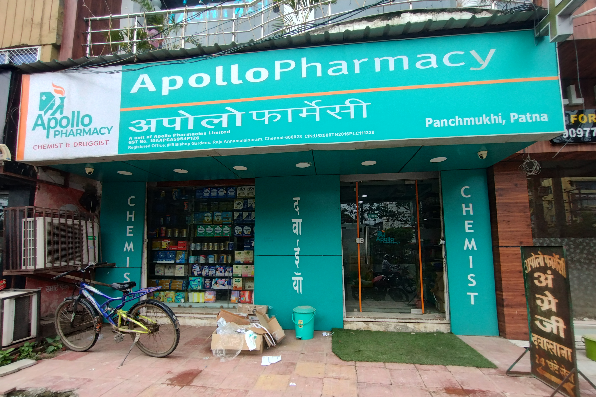

Executive summary
The business from where I collected data is a medium sized Apollo Pharmacy store, a franchise of Apollo Pharmacies opened in 2018.
The store offers a wide range of medicines and other health related products.
Unfortunately the store has been encountering challenges in terms of inventory management and sales due to competition in market.

Slide 4

01
Data Collection & Cleaning
I collected 3 months data of nearly 20 items of 5 different categories. As Apollo has a computerised billing system so it was easy to get the sales data.
Data collected for analysis was primary data and was in a different format which was converted to feed it in Excel.
To consolidate and clean the data Excel was used. Excel was used for futher future analysis.

Slide 5

02
Data Analysis
Revenue and Sales
Lower Sales in the first half of April.
Sudden hike in Sales from mid-April, got up to decent sales till April end, but started decreasing.
In May, gradual decrease in Sales until June and further.

Slide 6
02
Data Analysis
Apollo vs Competitors
Notes:
2-graph) shop is prosperous in Milk & Dairy , Cooking oil sales but their contribution to the overall profit remains significantly lower to that
of others hence lower net profit

Slide 7
02
Data Analysis
Apollo vs Competitors
In each Product Category Apollo has lower sales than its competitors.
Apollo’s sales in “Cold & Flu” and “Vitamins and Supplements” categories are almost half to that of its competitors.
It can clearly be seen the main reason is Discounts, as in the graph Apollo’s Discounts are 3-5% lower than its competitors.
This shows how Apollo is facing challenges due to its competitors and their discounts.
Notes:
2-graph) shop is prosperous in Milk & Dairy , Cooking oil sales but their contribution to the overall profit remains significantly lower to that
of others hence lower net profit

Slide 8
02
Data Analysis
Inventory
There were many stockouts faced in the month of April, few in May and in June its almost zero, the main reason being reduces sales.
Items like, Antacids, Fish Oil, Isabgol, Multivitamin, Vitamin C most frequently got out of stock.
Inventory issues leads to unsatisfied customers.

Slide 9
03
Findings
Better Discounts by competitors reducing footfalls and hence, sales at Apollo.
Sales of categories like “Cold & Flu” and “Vitamins & Supplements” are much more affected by competitors as they are half as that of the competitors due to several reasons like more discounts and better inventory management.
Frequent stockouts of products shows problems in inventory management, this leads to unsatisfied customers.

Slide 10

04
Final Recommendations
Category or product specific discounts particularly in “Cold & flu and “Vitamins & Supplements” category
Optimize discount strategies to compete with others
Restocking earlier than usual or during high sales period
Increasing restock amounts i.e. having extra stock for high demand products
More discounts than competitors in categories such as “First Aid” which have large margins
Customer Relationship management (CMR) system to record customer preferences and purchase history

